Slide 1
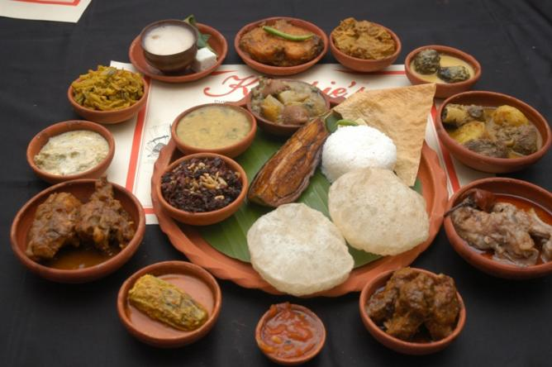
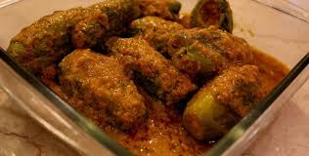
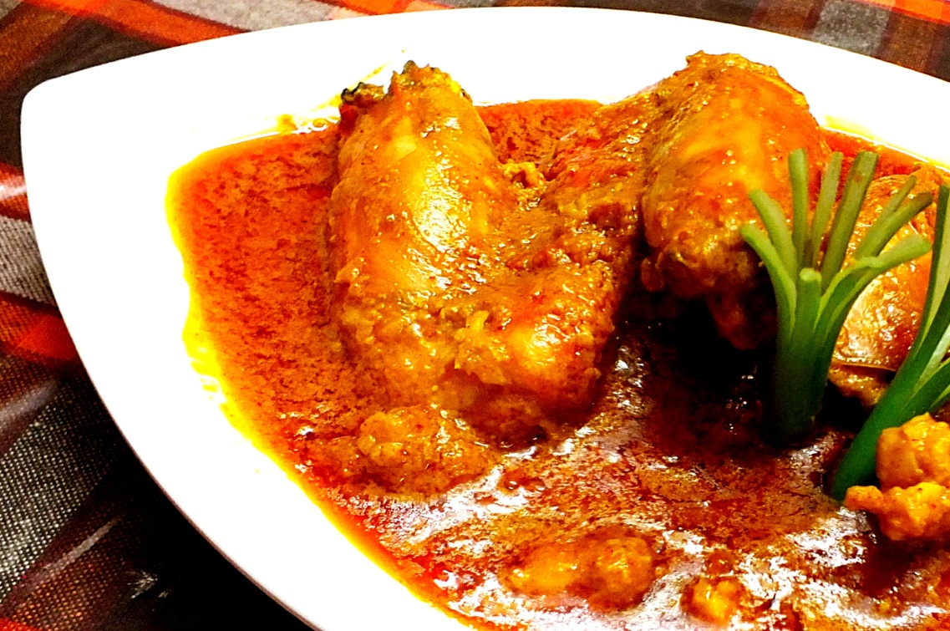
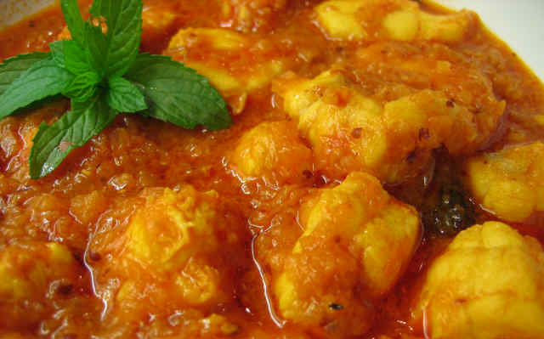
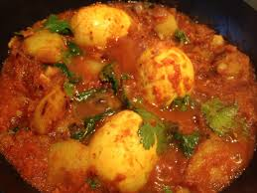
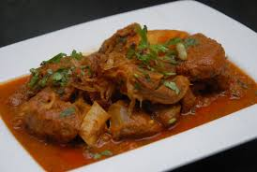
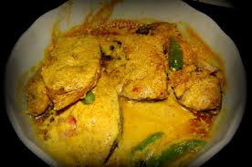
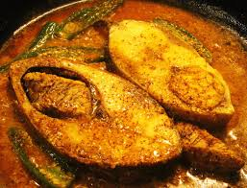
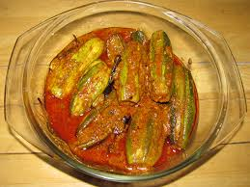
Home
Contribute Recipe
View Recipe
Sign up
Login
Bengalee Rasana…
Search recipe
Login
Enter your emailId
arupa.datta
@yahoo.com
Password
llllllllllll
Forget password
Login
Not a member yet? Sign up

Slide 2
Home
Contribute Recipe
View Recipe
Sign up
Login
Sign up
Login
First Name
Enter your email Id
Last Name
arupa.datta
@yahoo.com
Enter your email Id
Password
llllllllllll
Reenter your email Id
Forget password
Login
Enter your password
Not a member yet? Sign up
Reenter your password
Sign up

Slide 3
Home
Contribute Recipe
View Recipe
Sign up
Login
Sign up
Why do you sign up?
First Name
Last Name
Enter your emailId
Reenter your emailId
Enter your password
Reenter your password
Sign up
Already a member? Login

Slide 4
Home
Contribute Recipe
View Recipe
Sign up
Login
Enter email Id
Reset password

Slide 5
Home
Contribute Recipe
View Recipe
Sign up
Login
Send my password reset code to
*****tta@yahoo.com
222-222-2222
Enter verification code
Reset password

Slide 6
Home
Contribute Recipe
View Recipe
Sign up
Login
Enter new password
Re-enter new password
Change password

Slide 7
Home
Contribute Recipe
View Recipe
Sign up
Login
Your password has been successfully reset. Login

Slide 8
Home
Contribute Recipe
View Recipe
Sign up
Login
We are Sorry

Slide 9
Home
Contribute Recipe
View Recipe
Welcome Jhilik!
Not you?
Sign up
Logout
We are Sorry

Slide 10
Home
Contribute Recipe
View Recipe
Sign up
Login
Security Questions
Question 1*.
Select one
Answer 1*.
Question 2*.
Select one
Answer 2*.
Question 3*.
Select one
Answer 3*.
Submit
Remind me later

Slide 11
Home
Contribute Recipe
View Recipe
Welcome Jhilik!
Not you?
Sign up
Logout
Your account has been created successfully. Home

Slide 12

Home
Contribute Recipe
View Recipe
Welcome Jhilik!
Not you?
Sign up
Logout
Bengalee Rasana…
Search recipe
Login
Welcome
Jhilik

